Slide 1
Matrix Algebra
2.4 Partitioned Matrices
Bumhee Cho

Slide 2
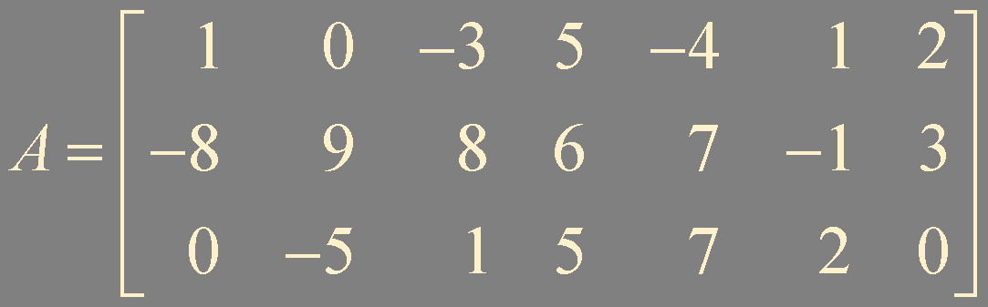
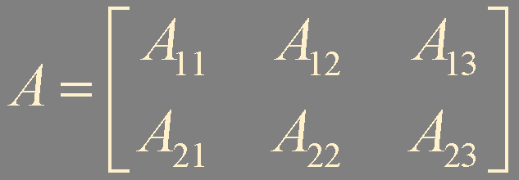
Partitioned Matrix
Addition and Scalar Multiplication
A + B
rA

Slide 3
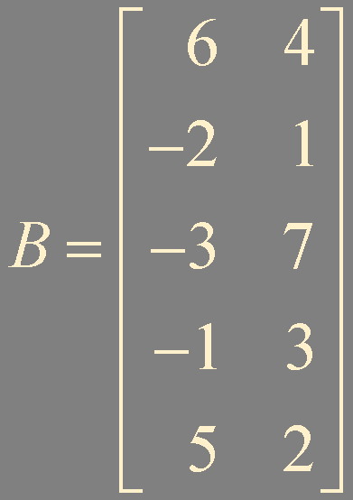
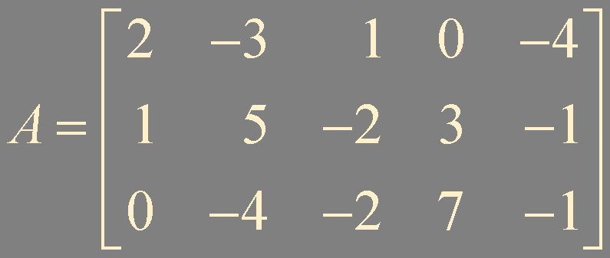
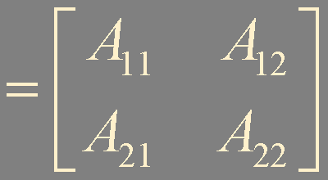
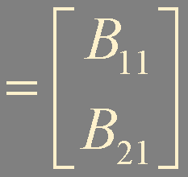
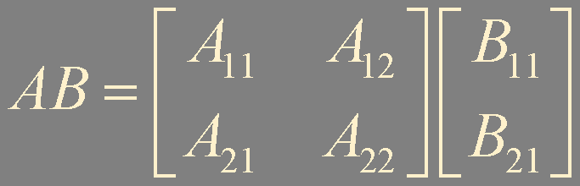
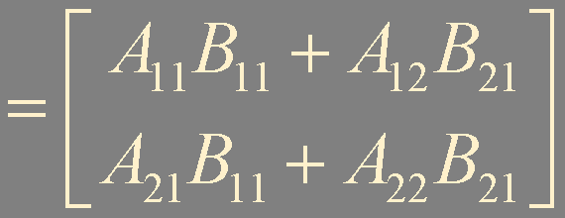
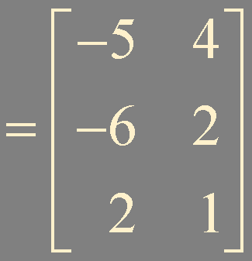
Multiplication of Partitioned Matrices
The partitions of A and B are conformable for block multiplication

Slide 4
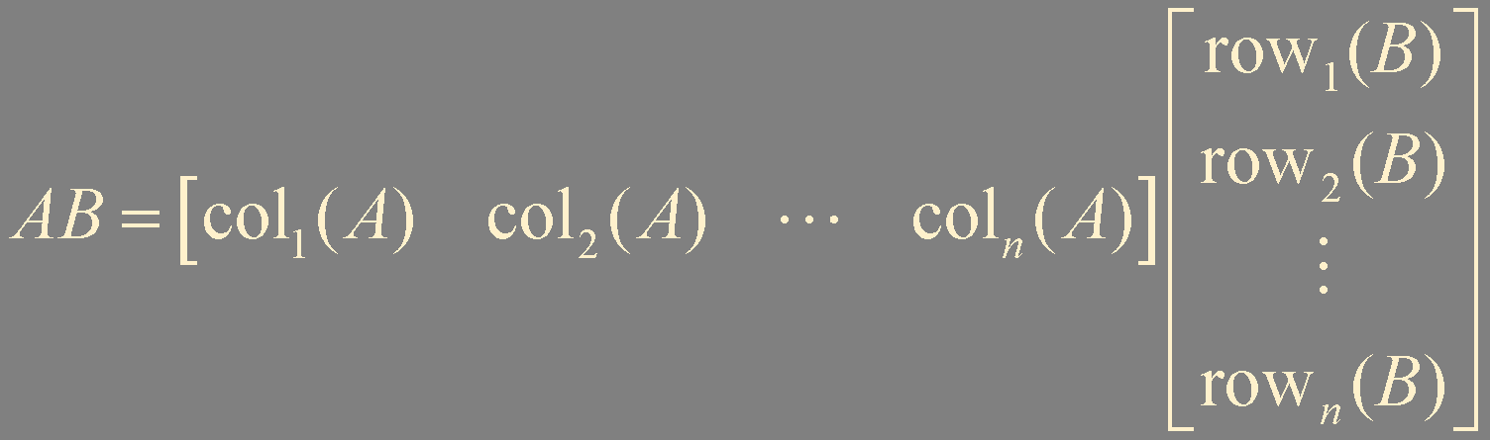

Theorem 10. Column-Row Expansion of AB
If A is m × n and B is n × p, then

Slide 5
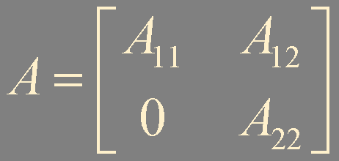
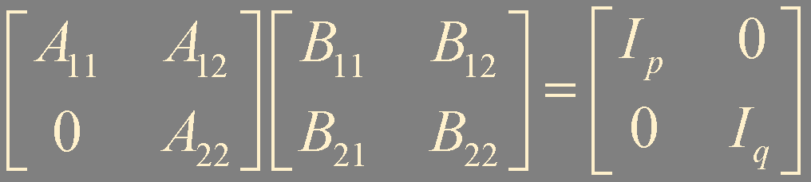
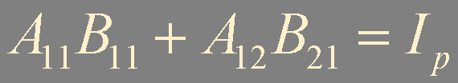


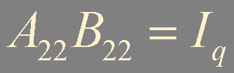
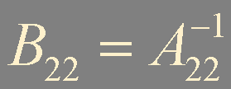
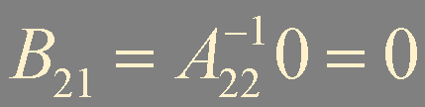

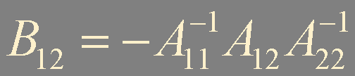
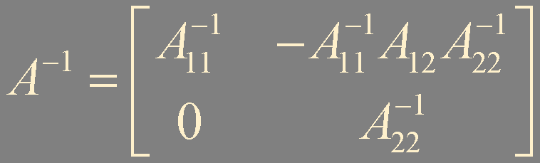
Inverses of Partitioned Matrices
p × p
block upper triangular
q × q
Notes:
사실, A 가 invertible이면 A11 A22도 invertible 이라는 말과 동치입니다.

Slide 6
Summary
Partitioned matrix
Multiplication of partitioned matrices
Column-row expansion
Inverse of partitioned matrix

